Slide 1

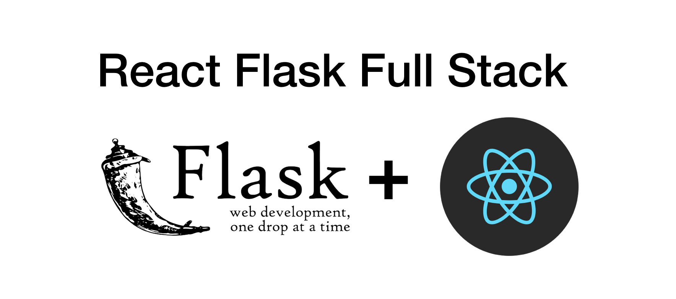
PyTorch Model Visualization

Slide 3
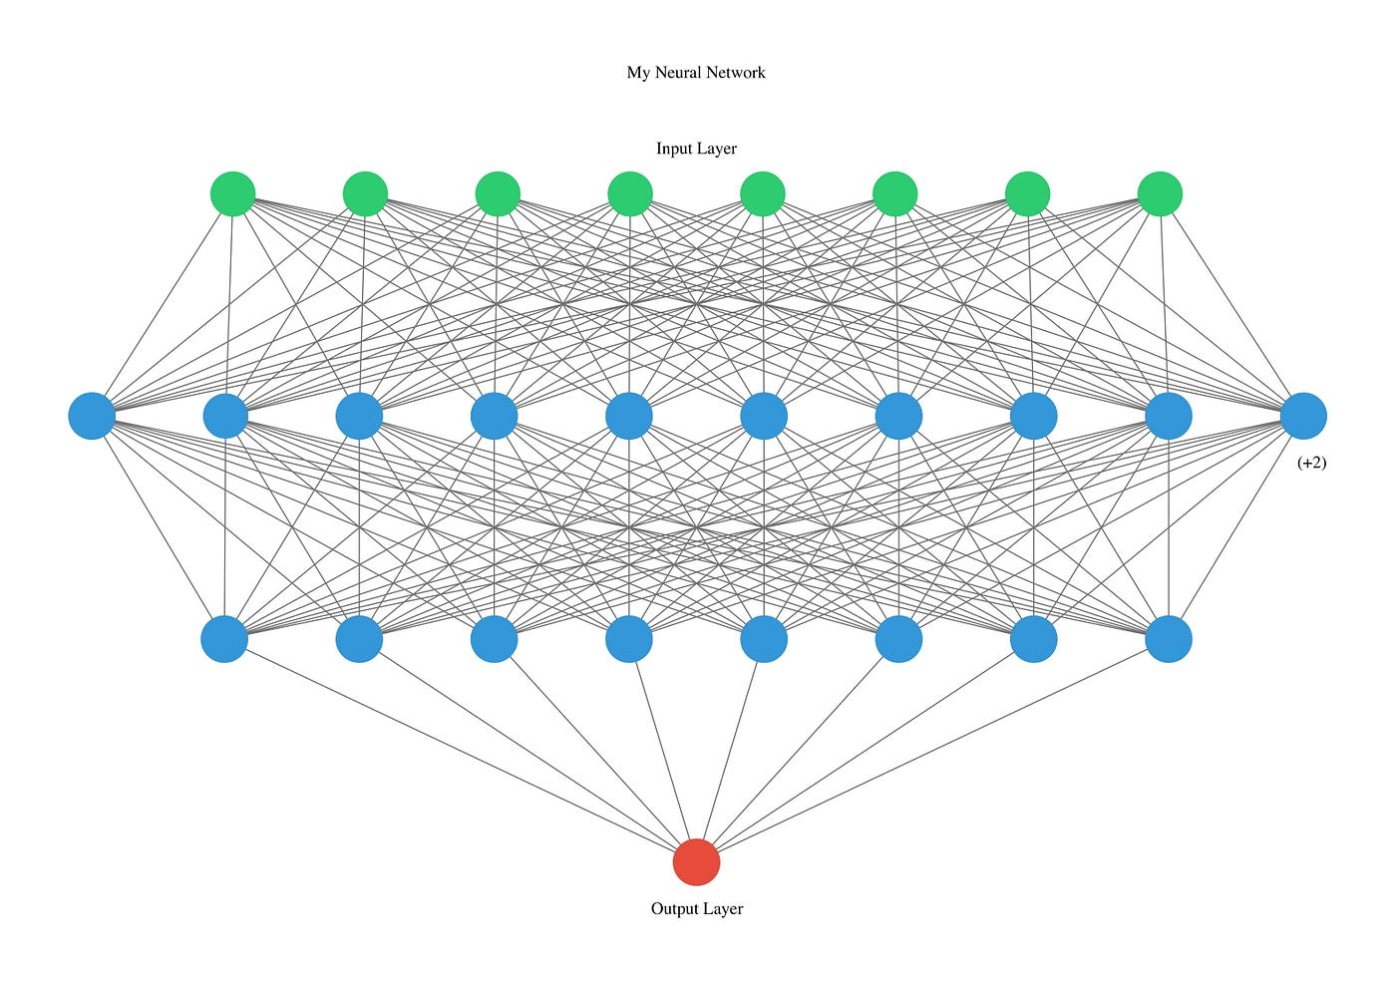

Slide 4
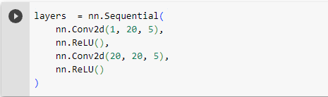
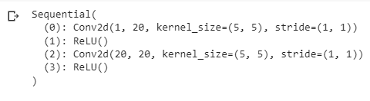

Slide 5
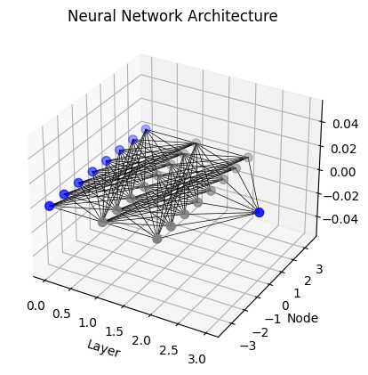

Slide 6
React Frontend
Text Input for Neural Network Architecture
Python Flask Backend
Generate Neural Network Architecture

Slide 7
Frontend : ReactjJS to build the UI and to receive the input for the model
Model Processing: Parsing of Text to identity the number of layers and number of neurons using Python
NeuralNetwork Image Generator: Generate Image using Matplotlib
Notes:
Frontend[ReactJS,Python Flask]
Pei yee
Clare
Text Editor, Forms, Connect with backend Python flask to transmit info and receive image, Display/Download Image
—-----------------------—-----------------------—-----------------------—-----------------------—-----------------------—-----------------------—-----------------------
Backend(Model Processing)[Python Flask]
Chocka
Process text, identify the number of layers, neurons for each layer, Python Flask
—-----------------------—-----------------------—-----------------------—-----------------------—-----------------------—-----------------------—-----------------------
Backend(Image Generator)[Python Flask]Matplotlib
Nancy
Sheng
How to use Matplotlib, GraphViz to generate neural network architecture, Python Flask how to transmit image from backend to frontend
—-----------------------—-----------------------—-----------------------—-----------------------—-----------------------—-----------------------—-----------------------

